Slide 1

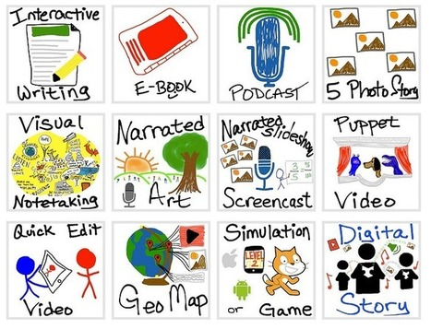


Universal Design o f Learning (UDL)
and
Use of Technology
Prof (Dr.) Renu Malaviya
University of Delhi
malaviyadelhi@gmail.com

Slide 2
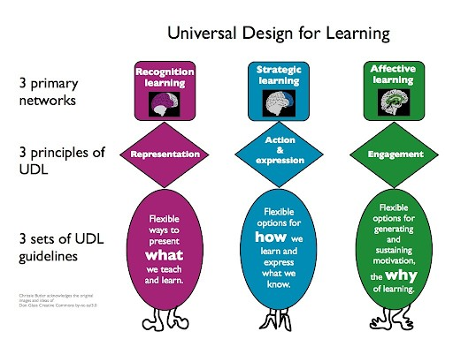
Universal Design of Learning (UDL)
a teaching approach that works to accommodate the needs and abilities of all learners and eliminates unnecessary hurdles in the learning process.

Slide 3
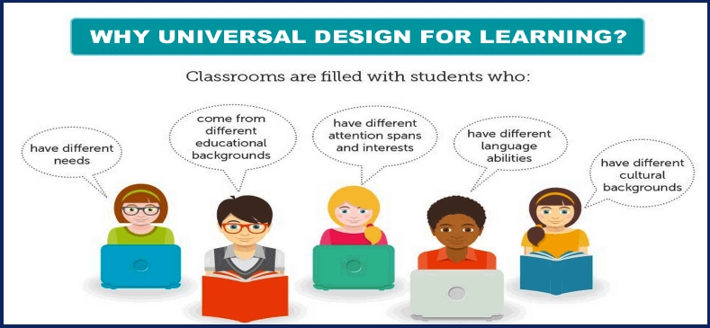

Slide 4
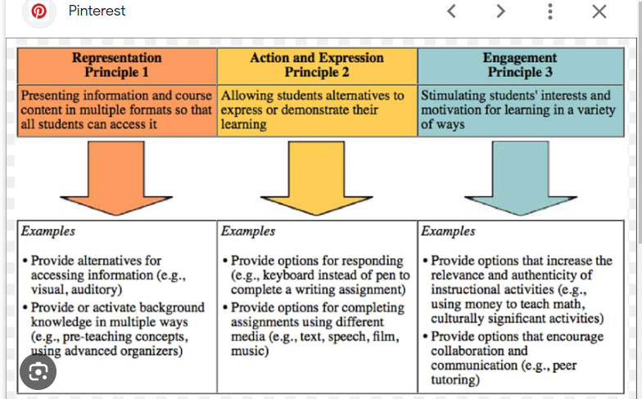

Slide 5
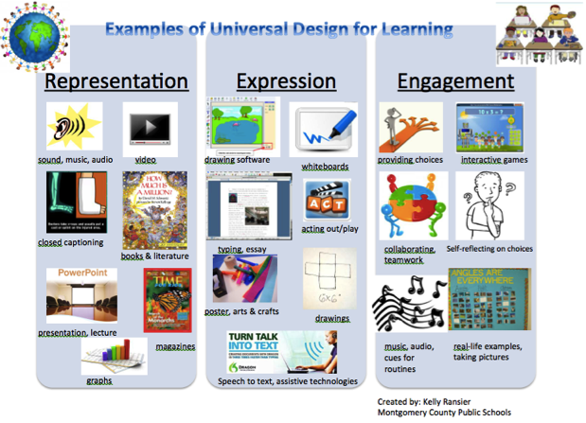

Slide 6
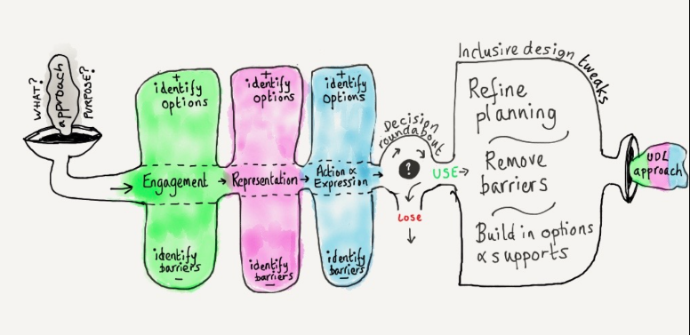
Key Elements of UDL Lesson Planning

Slide 7
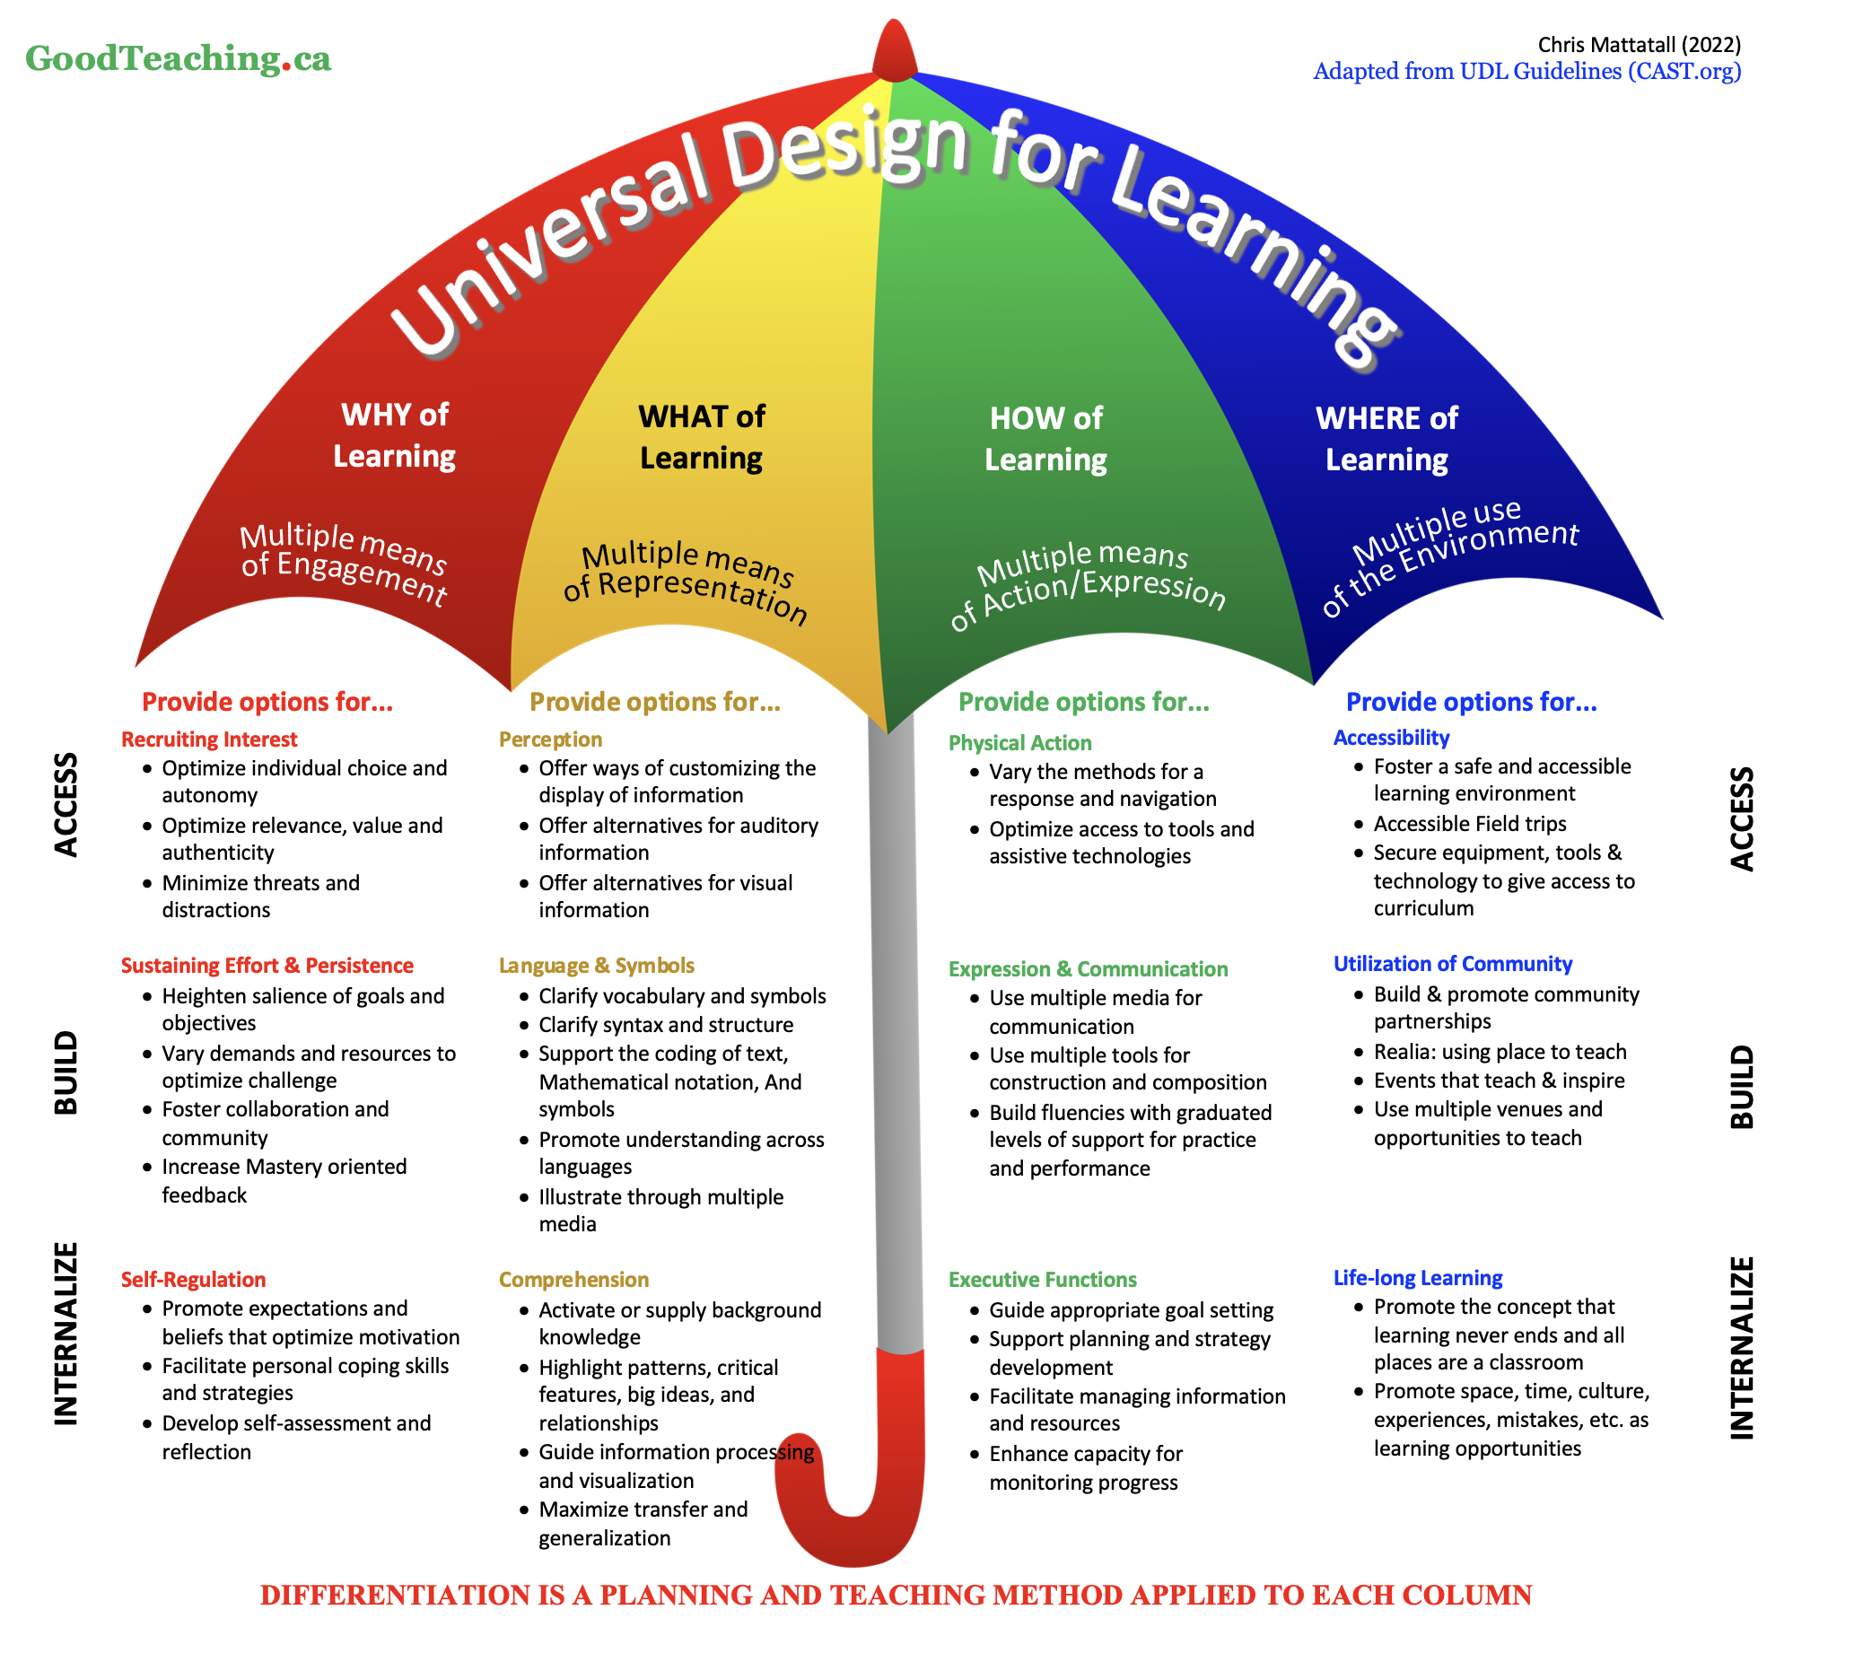

Slide 8
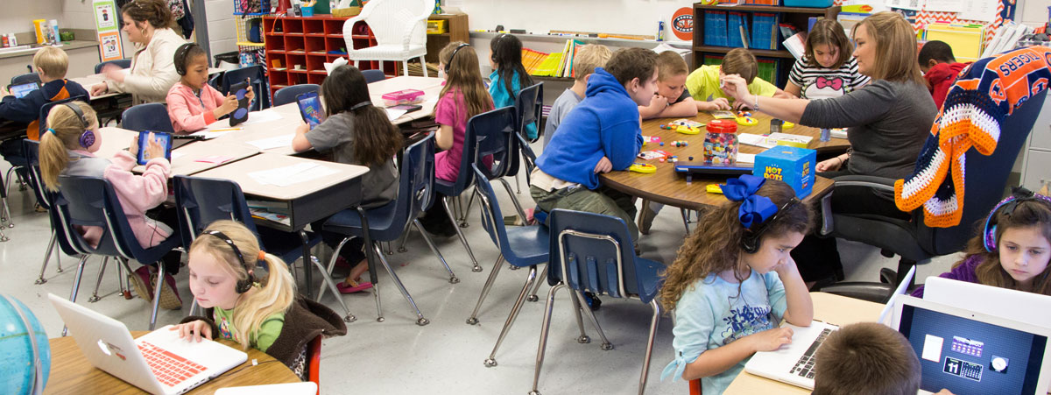




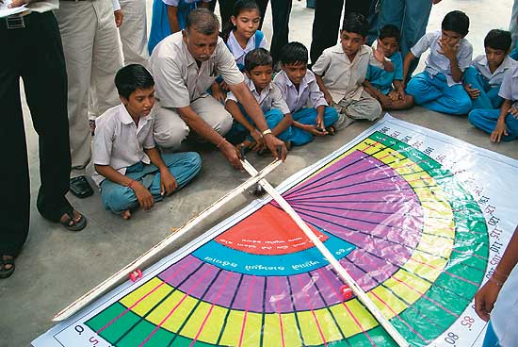
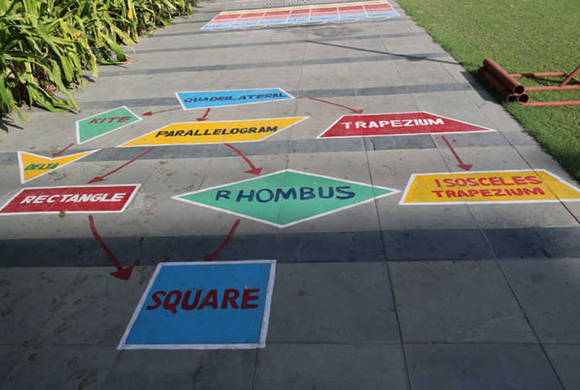
Engagement ( “Why” of Learning)

Slide 9
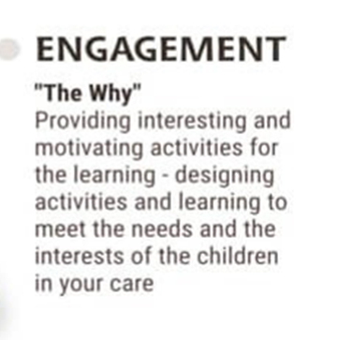
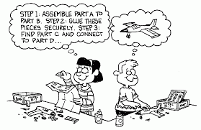
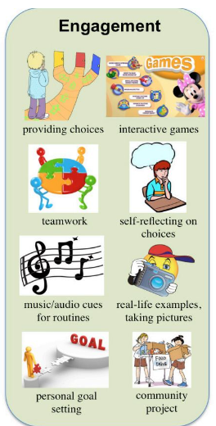
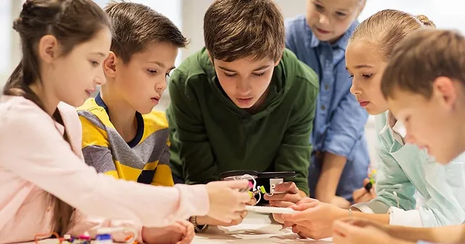
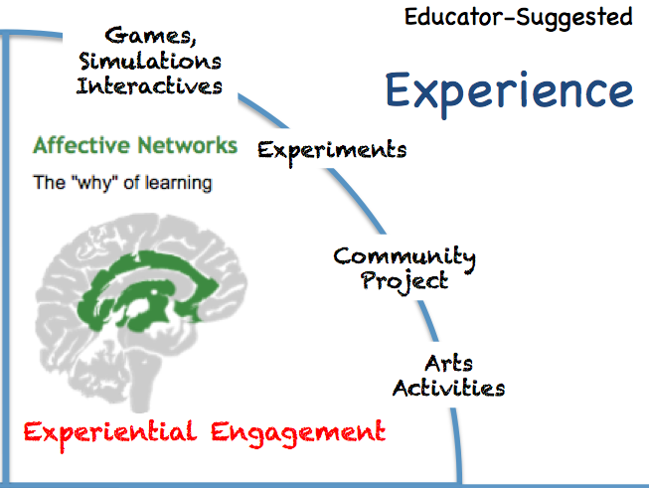


Slide 10
active participation, exploration and experimentation
Design activities so that learning outcomes are authentic, communicate to real audiences, and reflect a purpose that is clear to the participants
Invite personal response, evaluation and self-reflection to content and activities
Include activities that foster the use of imagination to solve novel and relevant problems, or make sense of complex ideas in creative ways
Create cooperative learning groups with clear goals, roles, and responsibilities – many of these activities require cooperative learning.

Slide 11

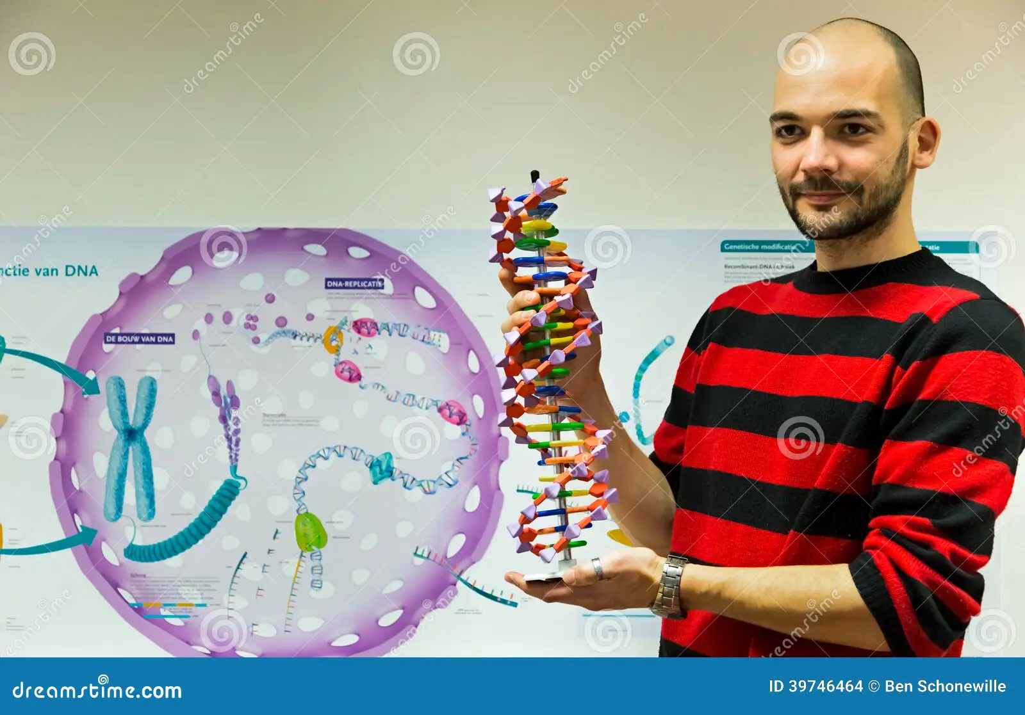


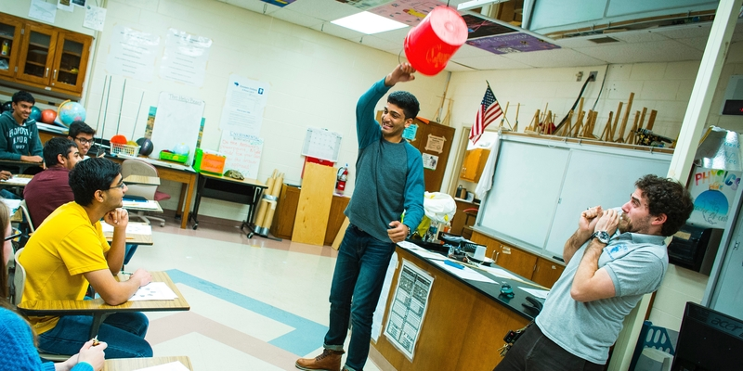
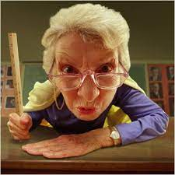
Representation ( “What” of Learning)– What do I do!!!

Slide 12

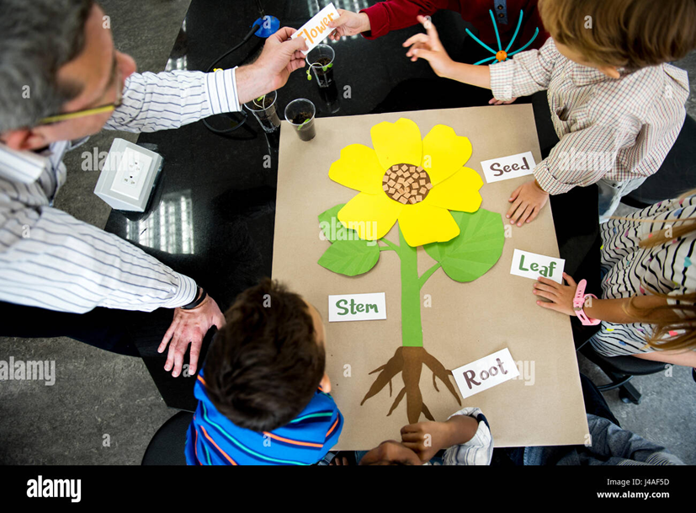
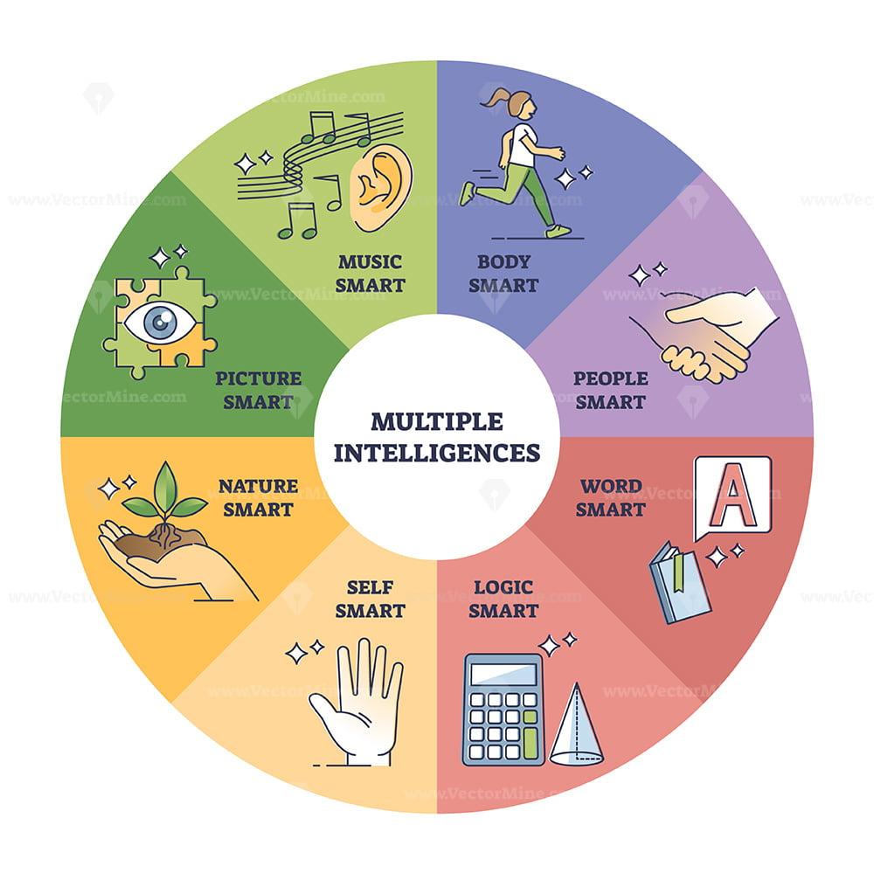

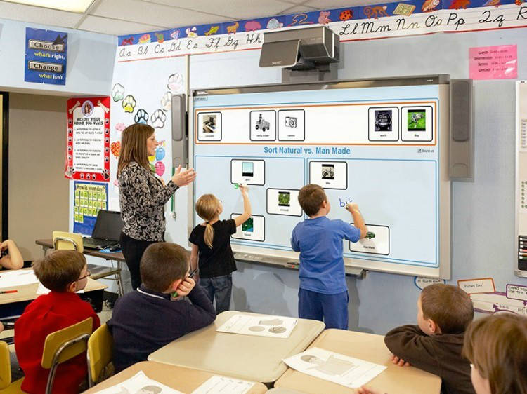
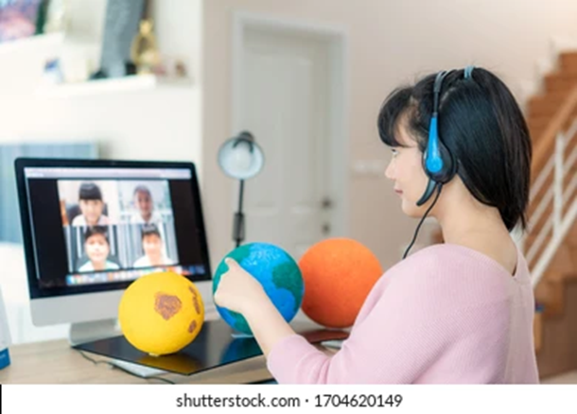
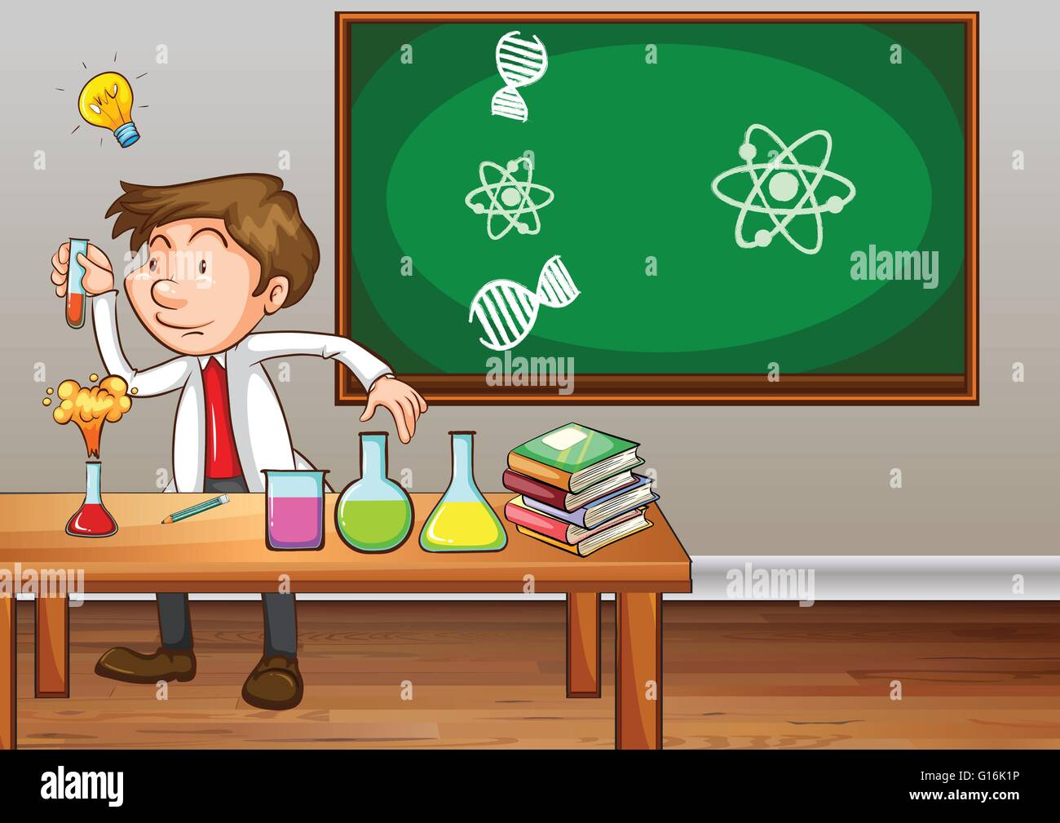


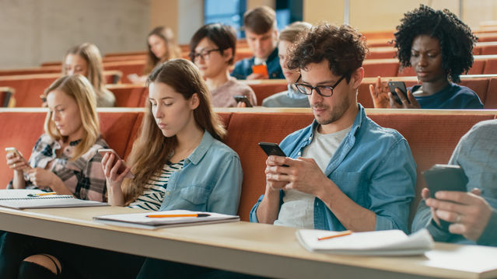
Different Means of Representation

Slide 13
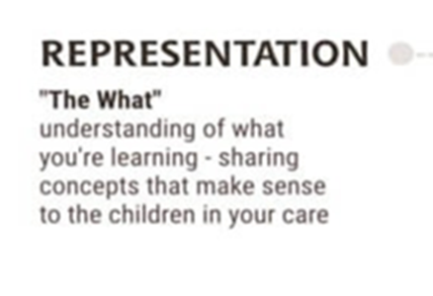
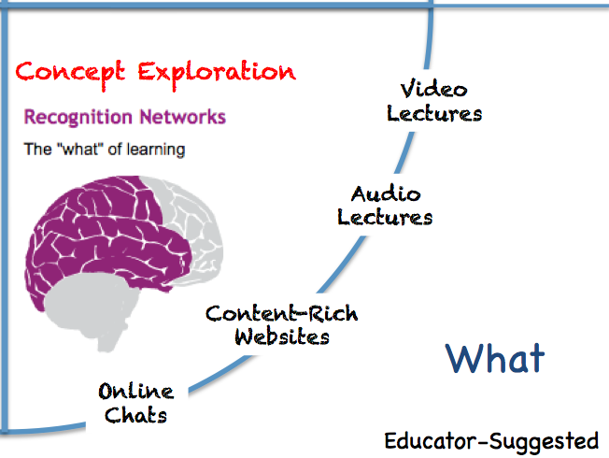
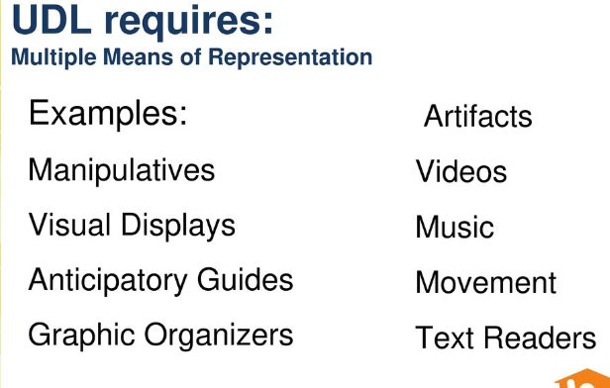

Slide 14
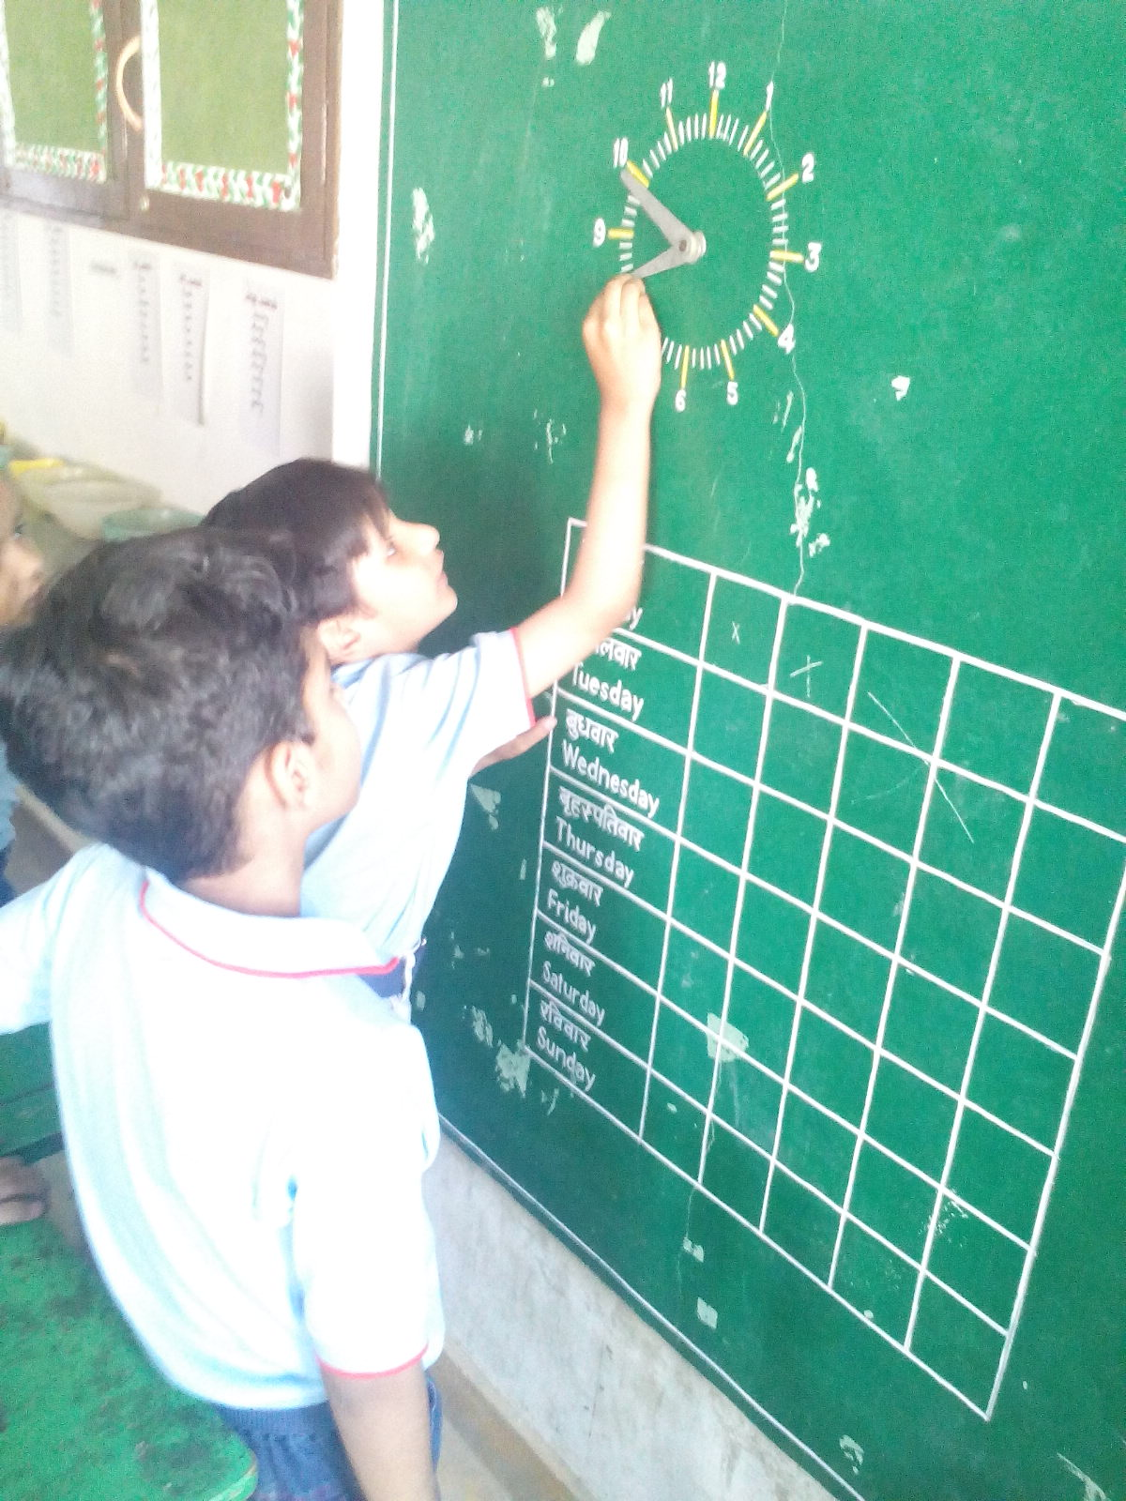
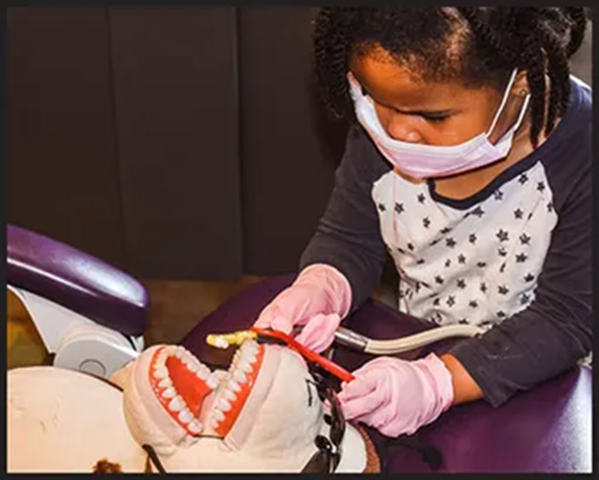
Action & Expression ( How I express my learning)

Slide 15
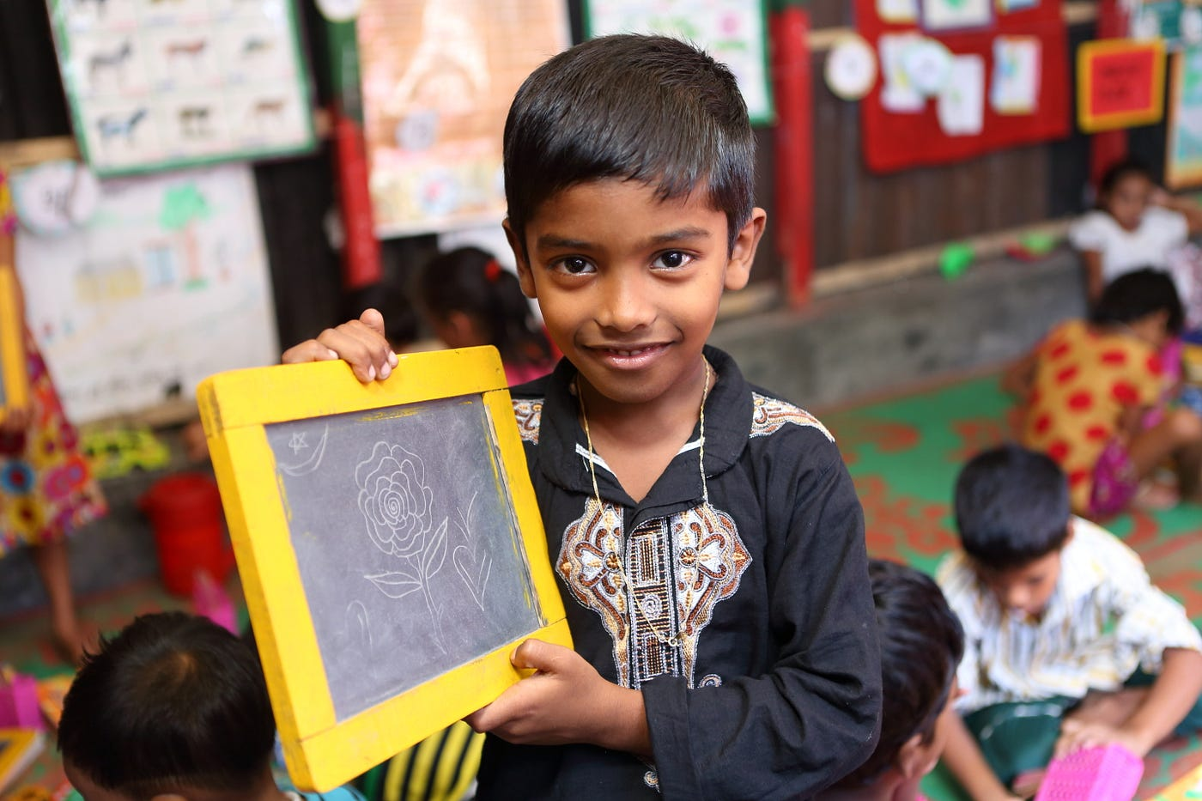
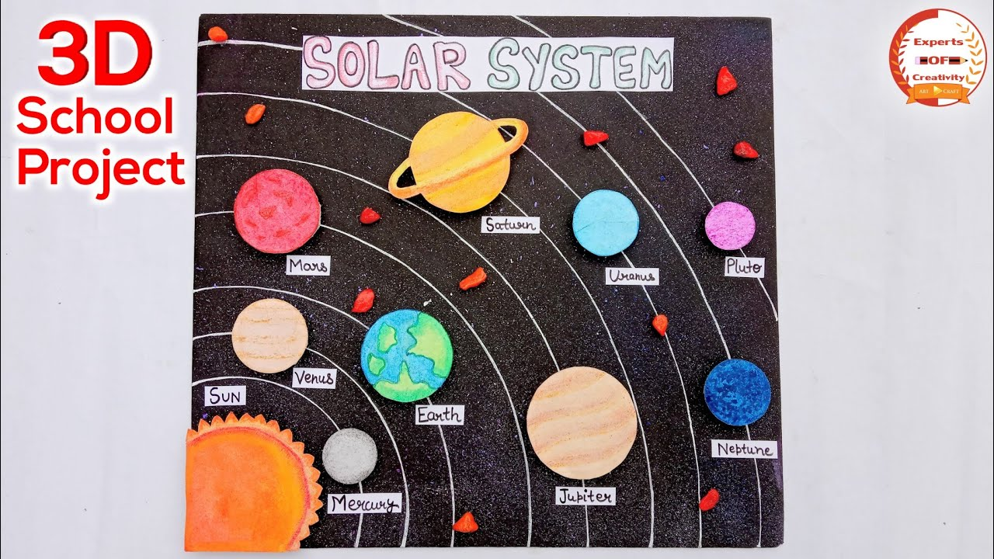
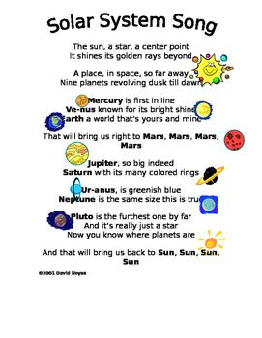

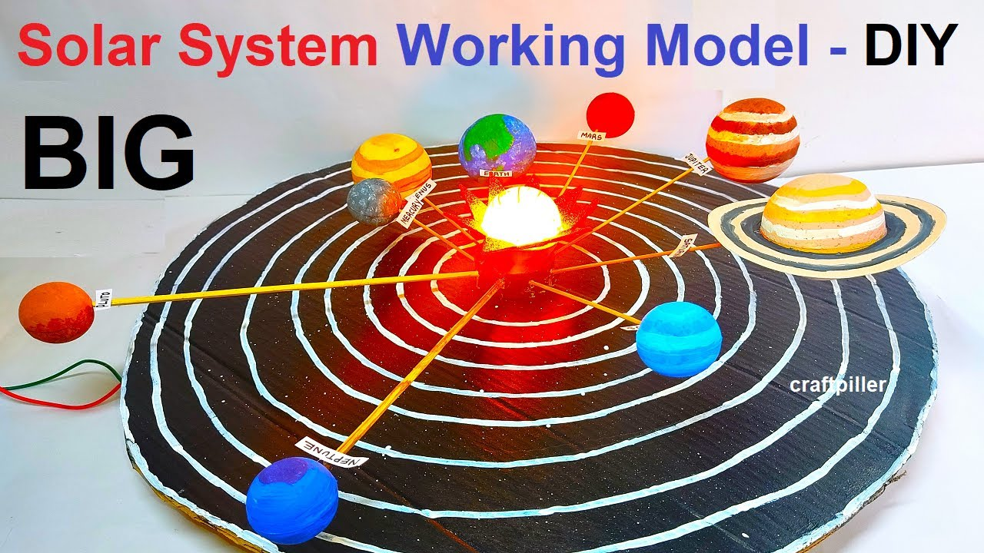



Slide 16
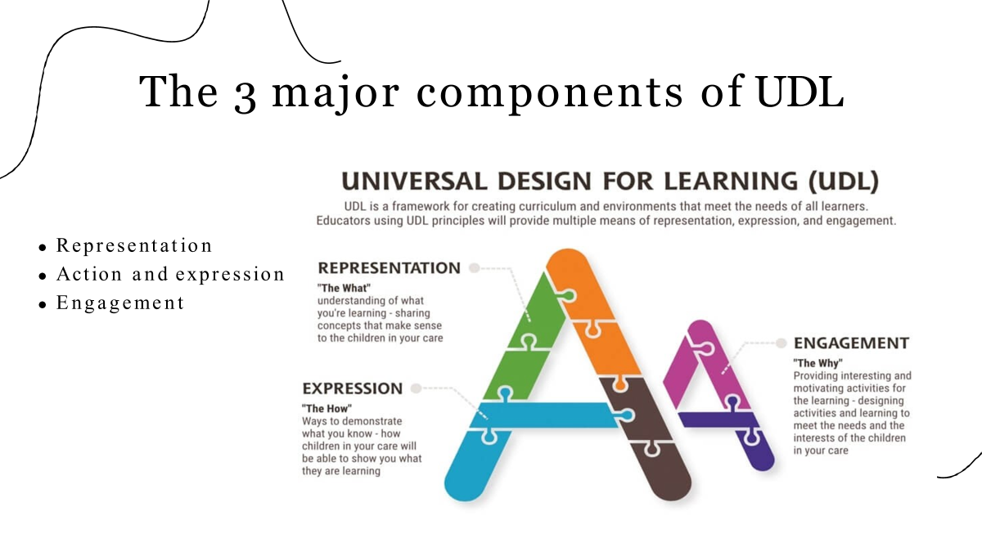
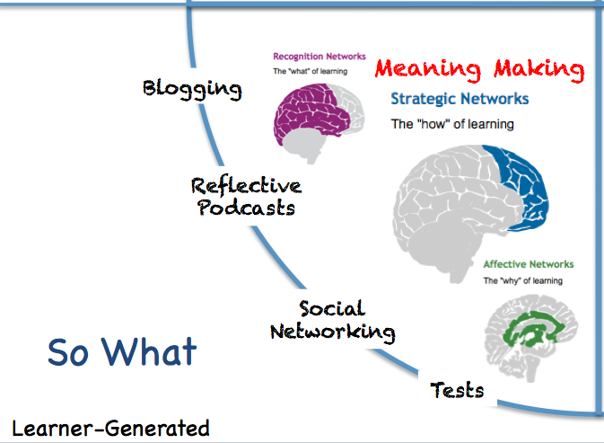
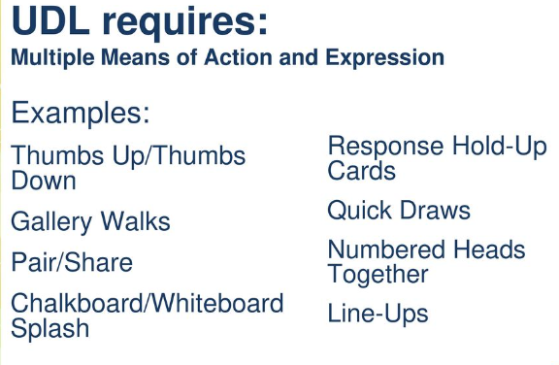

Slide 17
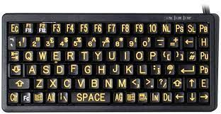
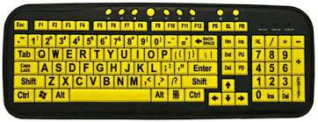
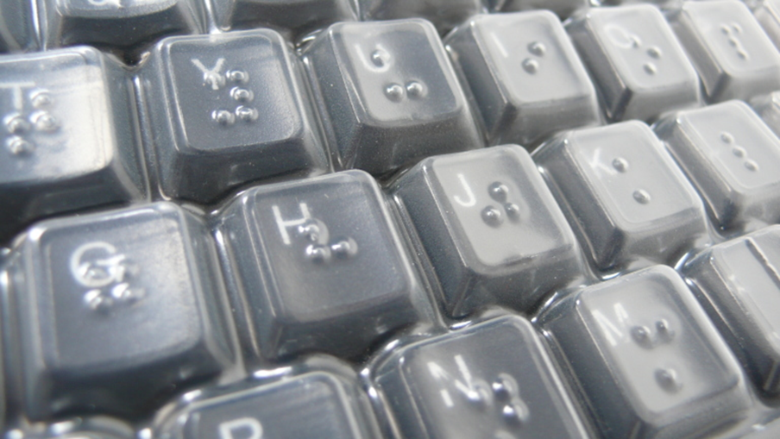
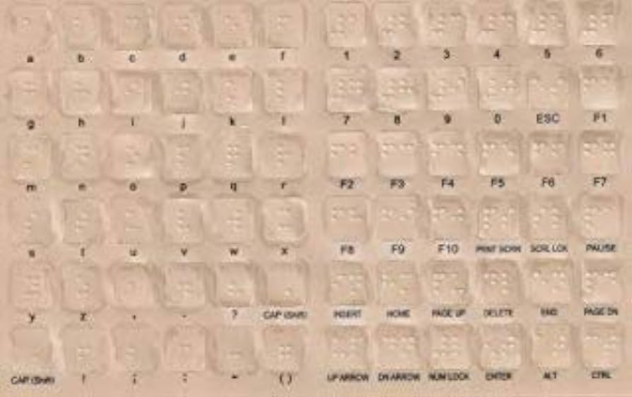
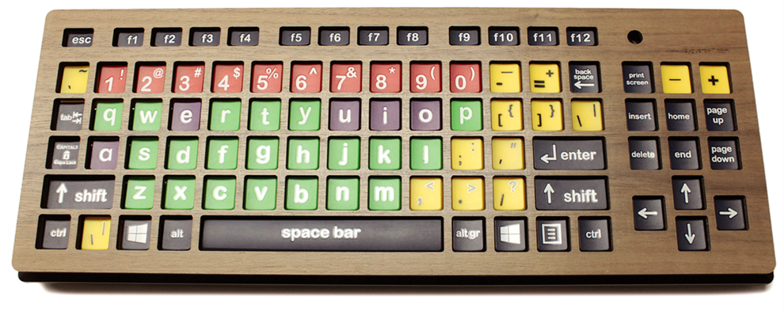
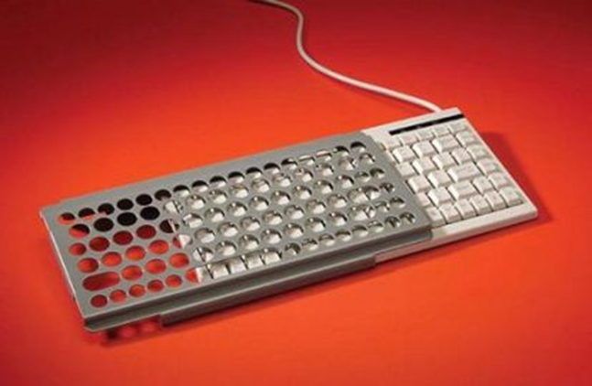
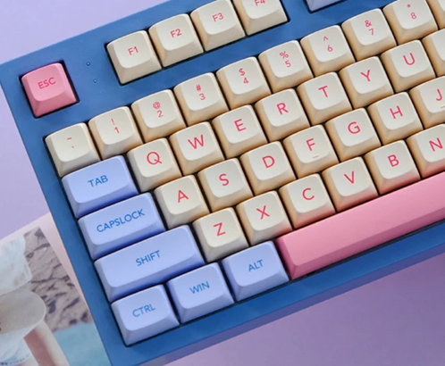
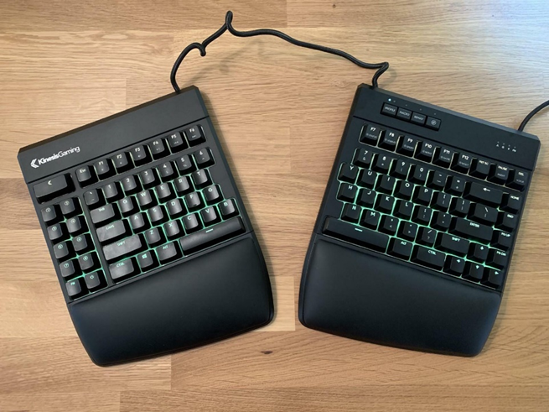
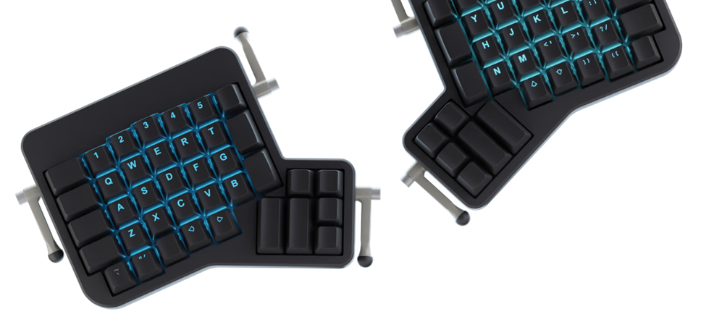
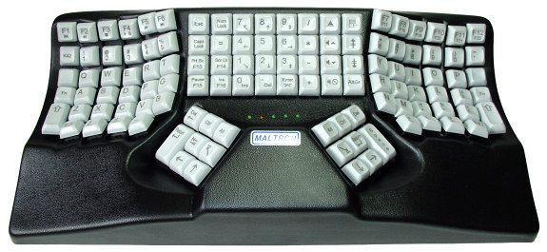
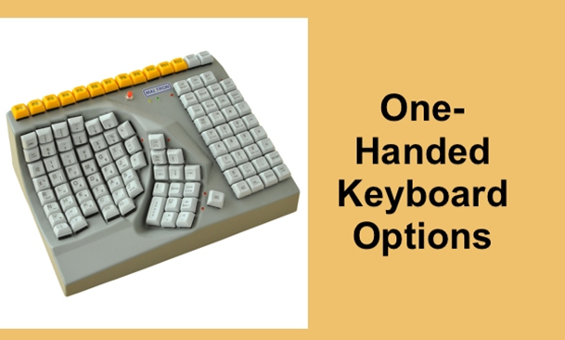

Slide 18
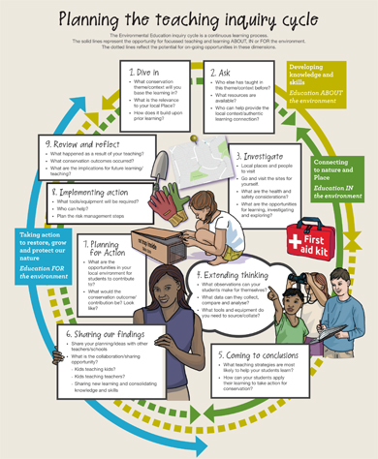
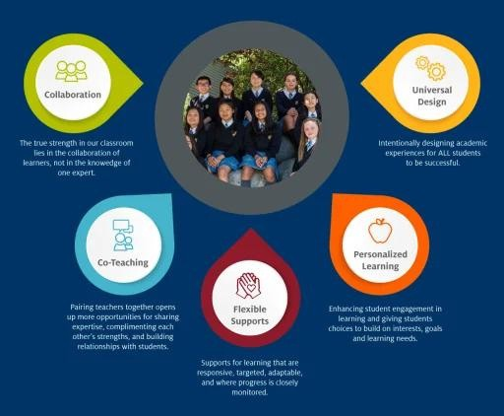
ULD facilitates Inclusive Education

Slide 19

.
Does Technology facilitate UDL
Or
Is Use of Technology in the classroom called UDL

Slide 20
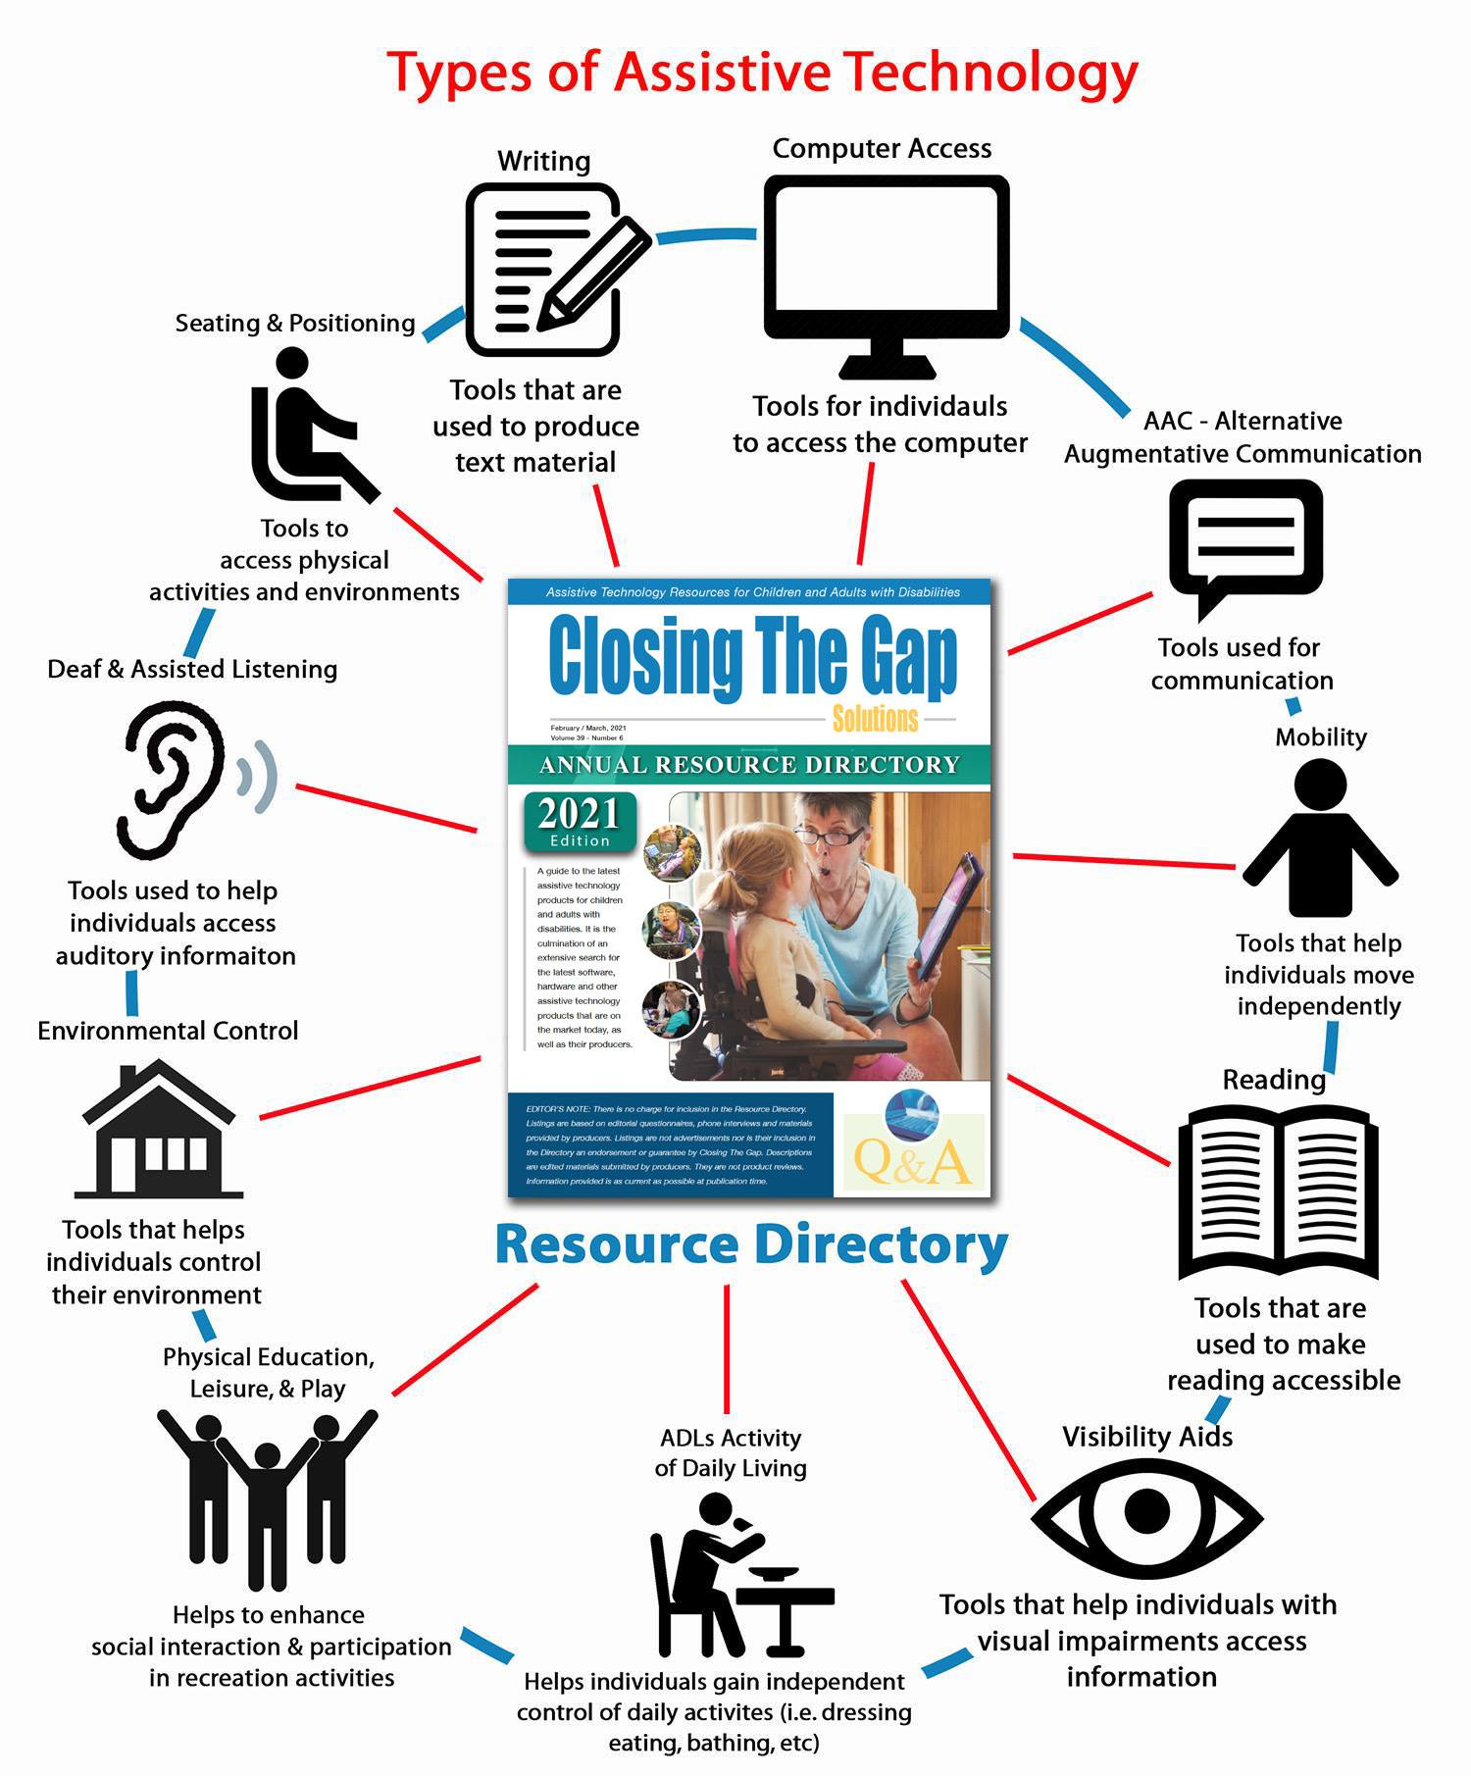

Slide 21




Assistive devices for children with visual impairment in class
Screen Readers
Camera Scanners, OCR and text -to- speech
Smartphone text detection - OCR - text- to-speech apps
Daisy Player
Braille displays and notetakers Screen magnification
Graphing and Maths Technology Audio Books

Slide 22







Assistive devices for children with Hearing impairment in class
Hearing loop (or induction loop) systems FM systems
Infrared systems Personal amplifiers
Roger™ SoundField products Bluetooth systems
infrared system

Slide 23




Assistive devices for child with specific learning disability in class
Mind mapping software
Scanning software and hand reading pens Spell checkers
smartpens
Tablets, Smartphones and Applications Computer based learning programs Mind Mapping
Dictaphones and Handheld Devices

Slide 24





Slide 25





Slide 26





Using video (technology)
.

Slide 27





Assistive devices for child with ASD in class

Slide 28






Assistive devices for dyscalcilia

Slide 29








Assistive devices for dysgraphia

Slide 30


Slide 31

.
Technology facilitates Universal Design of Learning (UDL)
BUT
Only using Technology is NOT Universal Design of Learning
(UDL)

Slide 32


Slide 33

21st centuries classes

Slide 34


Slide 35

21st centuries classes

Slide 36


Different Educational Practice

Slide 37

The 3 major components of UDL

Slide 38

There are eight areas of application
Inclusiveness Physical Access Delivery Methods
Information Resources Interaction
Feedback Assessment Accommodation

Slide 39

Technology Use for Teacher Professional Development

